Slide 1
Applications of Data Science
Exploring Real-World Impact Across Industries
OGUNTUGA DAMILARE OLUSEYE
September 6, 2024

Slide 2
INTRODUCTION TO data science applications
INTRODUCTION
September 6, 2024
CONTENT:
September 6, 2024
Brief definition of data science024
Importance of applying data science in real-world scenarios.
Overview of industries to be covered: Healthcare, Finance, Marketing.

Slide 3
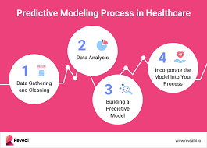
Data Science in Healthcare
Predictive Analytics: Identifying potential disease outbreaks and patient readmissions. 6, 2024
Personalized Medicine: Tailoring treatments based on individual genetic profiles., 2024
Visual: Chart showing improvement in patient outcome with data-driven approaches..
Example: IBM Watson Health use in cancer treatment. Finance,

Slide 4
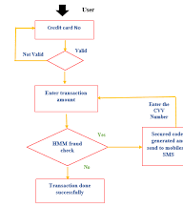
Data Science in Healthcare
Fraud Detection: Using anomaly detection algorithms to spot fraudulent activities.
Algorithmic Trading: Automated trading strategies based on data analysis.
Visual: Graph of financial market trends analyzed through data science.
Example: Credit scoring models and risk assessment tools used by banks.

Slide 5
Data Science in Marketing
Customer Segmentation: Targeting specific customer groups with personalized marketing strategies. Sentiment Analysis: Analyzing customer feedback and social media to gauge brand sentiment..
Visual: Pie chart or bar graph showing the impact of personalized marketing on
Example: Netflix's recommendation system and targeted advertising.

Slide 6
CONCLUSION
Recap of the impact of data science across industries.
Future trends and emerging applications.2024
Quote: "Data science is not just a field but a cornerstone of innovation."
Visual: Summary infographic of key points discussed.,

